Slide 1
Data Structures and Algorithms -3 (25CS2103E)
Automated Plagiarism Detection System Using Rolling Hash Techniques
Team Members
Harshit Sajjanapu 2520030187
Krish Sureja 2520030134
Shammruth Bhuma 2520030191
Under the Esteemed Guidance of
Dr.Ch.Anuradha
Professor CSE

Slide 2
Contents
Abstract
Introduction
Literature survey
Problem Statement and Objectives
Hardware and Software requirements
Results
Conclusion
Future Scope

Slide 3
Abstract
Identifying copied content across textual documents efficiently requires fast, computationally optimized string comparison algorithms. This project presents an automated Plagiarism Detection System designed to evaluate multiple documents by generating polynomial hash values and locating matching text segments. By leveraging rolling hash techniques (such as the Rabin-Karp algorithm), the system processes sliding text windows in O(N) time complexity, enabling rapid multi-document comparison.
To ensure precision, the backend engine strictly handles hash collisions by performing direct string verifications whenever matching hash values are detected. The platform automatically calculates and reports similarity percentages across document pairs and renders an intuitive visualization interface that highlights duplicated passages in real time. Developed with a React.js frontend for dynamic text highlighting, a Node.js execution server for hash computation, and MongoDB for document storage, this project demonstrates an end-to-end implementation of efficient document comparison and collision handling techniques.

Slide 4
Introduction
Plagiarism detection is essential in academic, professional, and digital content environments.
Manual comparison of large documents is time-consuming and inefficient.
Traditional approaches may become computationally expensive when comparing multiple documents.
This project introduces an automated system that uses rolling hash techniques for rapid text matching.
The system compares document content, detects matching segments, calculates similarity, and visually highlights duplicated text.
The goal is to provide a fast, reliable, and user-friendly document comparison platform.

Slide 5
Literature Survey
Existing plagiarism detection methods use techniques such as string matching, fingerprinting, n-grams, and semantic analysis.
Traditional exact string comparison can become inefficient for large documents.
Hash-based algorithms improve performance by converting text segments into compact numerical representations.
The Rabin–Karp algorithm uses rolling hash values to efficiently locate matching patterns.
However, identical hash values can sometimes produce hash collisions, requiring additional verification.
Our proposed system combines efficient rolling hash computation with direct string verification and similarity analysis for reliable detection.

Slide 6
Problem Statement and Objectives
Problem Statement
Comparing multiple documents manually or using computationally expensive methods makes plagiarism detection slow and difficult to scale. An efficient mechanism is required to identify duplicated text accurately.
Objectives
Detect matching or duplicated text segments between documents.
Use Polynomial Rolling Hash / Rabin–Karp for efficient comparison.
Process text using sliding windows in O(N) time complexity.
Handle hash collisions through direct string verification.
Calculate document similarity percentages.
Highlight duplicated passages through an interactive user interface.

Slide 7
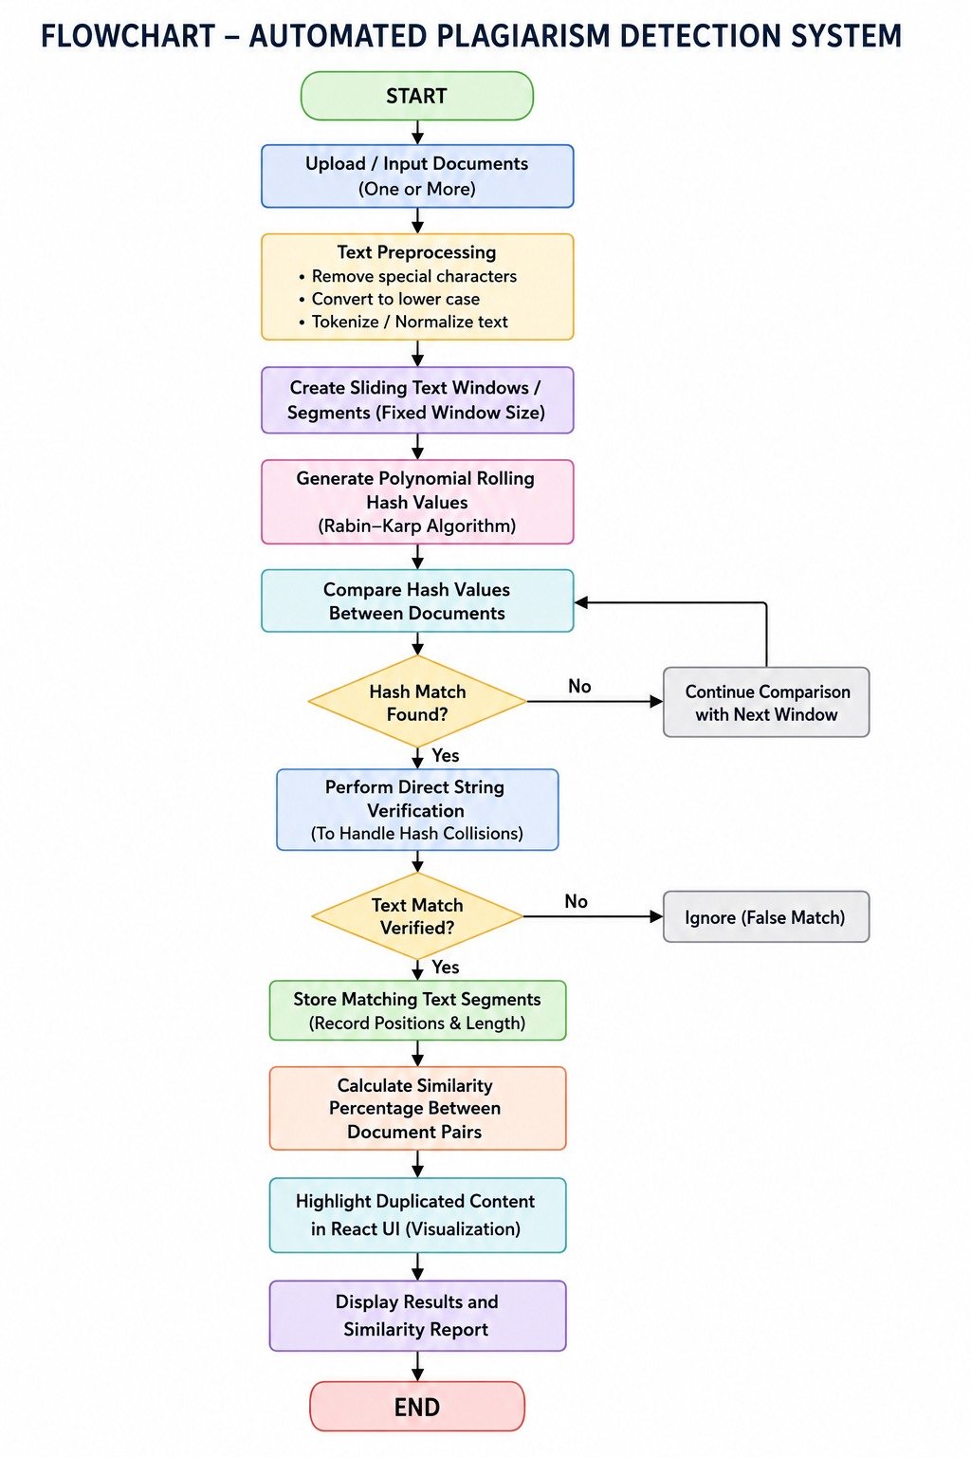
Flow Chart

Slide 8
Results
Successfully compares textual documents to identify duplicated content.
Generates hash values for text segments using the rolling hash technique.
Detects potential matching segments efficiently.
Performs direct string verification to eliminate false matches caused by hash collisions.
Calculates and displays similarity percentages between document pairs.
Highlights duplicated passages in the user interface.
Demonstrates efficient document comparison with improved speed and accuracy.

Slide 9
Hardware and Software requirements
Hardware Requirements
Processor: Intel i3 or above
RAM: 4 GB minimum, 8 GB recommended
Storage: Minimum 1 GB free space
Internet connection for deployment or online access
Software Requirements
Frontend: React.js, HTML5, CSS3
Backend: Node.js, Express.js
Algorithm: Polynomial Rolling Hash, Rabin–Karp
Database: MongoDB with Mongoose ODM
Development Tools: VS Code, Git, Postman
Platform: Windows/Linux/macOS

Slide 10
Conclusion
The project presents an efficient solution for automated plagiarism detection.
Rolling hash and Rabin–Karp techniques enable fast comparison of textual documents.
Direct string verification improves reliability by handling hash collisions.
The system provides both similarity analysis and real-time visualization of duplicated content.
Integration of React.js, Node.js, and MongoDB creates a complete end-to-end application.
The system demonstrates how efficient algorithms can improve the speed and effectiveness of document comparison.

Slide 11
Future Scope
Support for additional document formats such as PDF, DOCX, and TXT.
Integration of semantic analysis to detect paraphrased or meaningfully similar content.
Use of machine learning and NLP techniques for advanced plagiarism detection.
Support for large-scale comparison against extensive document repositories.
Cloud deployment for improved scalability and accessibility.
Generate detailed downloadable plagiarism reports.
Improve multilingual document comparison and detection capabilities.

Slide 12
Thank you

